Slide 1


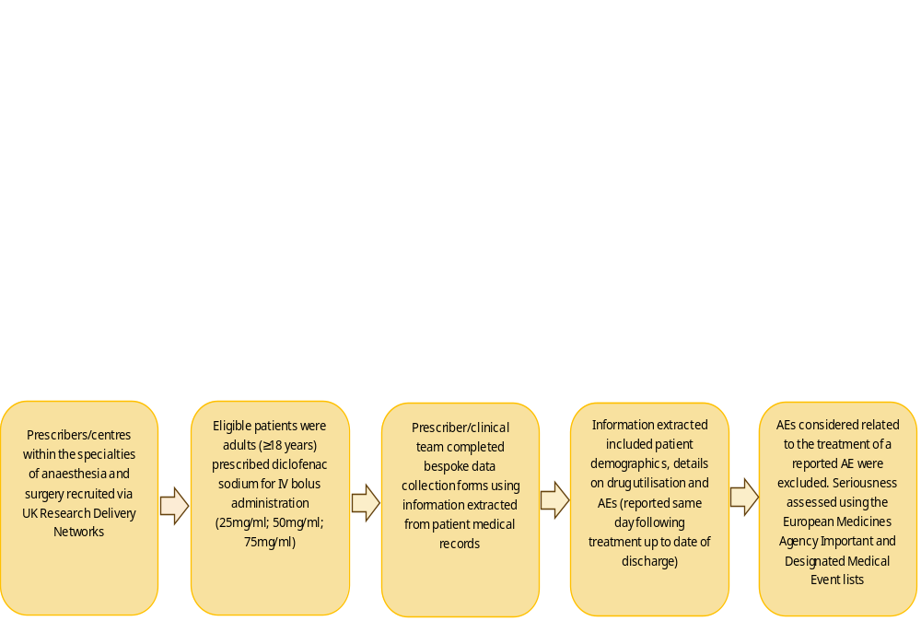

Utilisation and safety of IV bolus diclofenac sodium (Akis®) for prevention or treatment of post-operative pain in UK secondary healthcare
A. Evans^{1,2}, K. Morton^{1,2}, T. Aurelius^{1,2}, D. Morris^{1,2}, J. Denyer¹, D. Roy^{1,2}, L. Härmark¹
¹Drug Safety Research Unit, Southampton, United Kingdom
²University of Portsmouth, Portsmouth, United Kingdom
  INTRODUCTION
Clinical studies involving intravenous (IV) bolus administration showed potentially higher Cmax levels compared to other IV diclofenac products, raising concerns regarding the potential for increased incidence of adverse events (AEs). Therefore, a post-authorisation safety study was conducted to examine the utilisation and safety of the IV bolus formulation of diclofenac sodium for the prevention or treatment of post-operative pain, using a bespoke data collection approach.
OBJECTIVE
To assess the utilisation and safety of IV bolus formulation of diclofenac sodium for use in the prevention and treatment of post-operative pain in the UK secondary care setting.
  METHODS
  RESULTS
CONCLUSIONS
Results from this study showed that a large proportion of patients receiving diclofenac sodium were reported to have either a contraindication or special warnings and precautions for use. This may reflect either a lack of prescriber awareness of prescribing guidelines or an individual benefit-risk assessment made by the prescriber in view of the short duration of treatment with diclofenac sodium. The most frequent AEs were non-serious and expected postoperatively. Urinary retention was the most common serious AE reported, and is not listed in the SmPC, however it is acknowledged to be commonly observed in the postoperative setting. The tailored design of this study facilitated the assessment of a diverse patient population managed by specialist HCPs in secondary care, yielding a level of data fidelity not achievable with routinely collected data sources.
Site and patient recruitment
9 sites participated
Demographics
58.2% female
Indication
94.7% treated for prevention of pain
Risk factors
Adverse events
56.3% had one or more disorders listed as either a contraindication or special warnings and precautions in the Summary of Product Characteristics (SmPC)
297 AEs (237 non-serious; 60 serious) reported in 152 patients. Most frequently reported:
1592 eligible patients recruited between 4th May 2022 (study start) and 31st December 2024 (final report data lock point)
20.5% of males and females aged 51-60 years
5.3% treated for treatment of moderate to severe pain
pain (2.6%)
vomiting (1.0%)
nausea (0.9%)
219 AEs reported within 24 hours after the diclofenac sodium injection
78 AEs reported more than 24 hours after the diclofenac sodium injection
Cumulative incidence of serious AEs was low (2.7%); the highest incidence of any serious AE was 0.5% (urinary retention)
The DSRU is an independent charity (No 327206) which works in association with the University of Portsmouth. Funding has been received from the Marketing Authorisation Holder, IBSA Farmaceutici Italia Srl.

