Slide 1


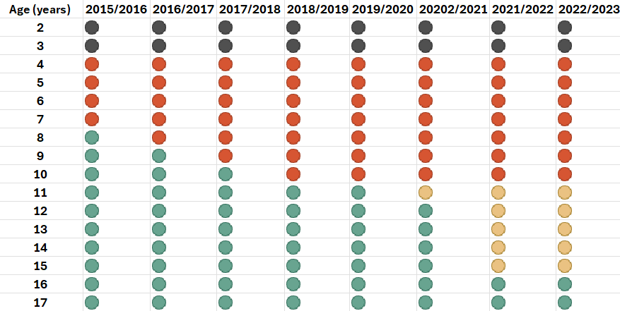
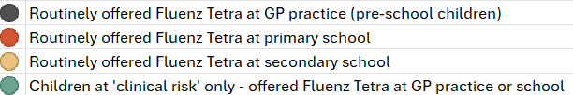
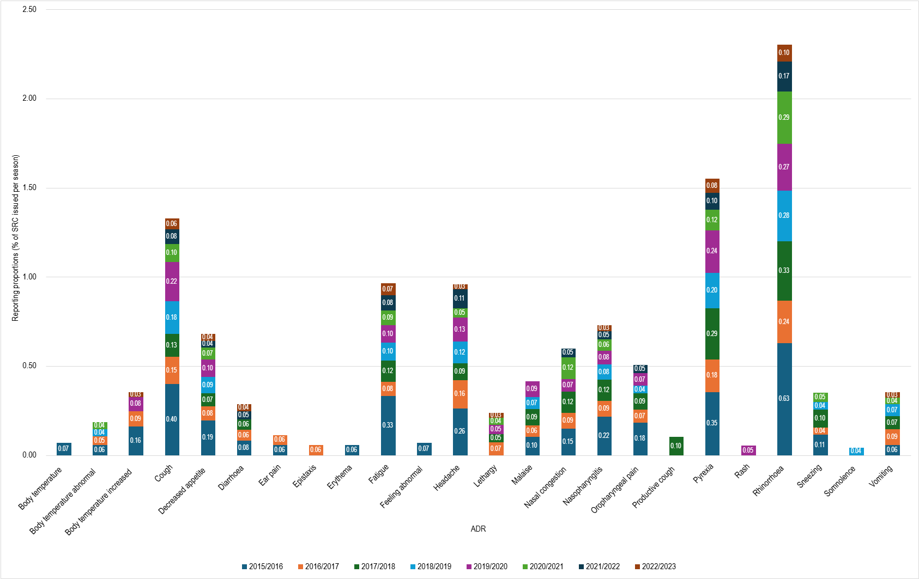

Enhanced Passive Safety Surveillance (EPSS) of Intranasal Influenza Vaccine (Fluenz® Tetra) in Children in England: Evaluation from Eight Seasons
(2015/2016-2022/2023)
S.Dhanda^{1,2}, D.Morris^{1,2}, L.Härmark¹
¹Drug Safety Research Unit, Southampton, United Kingdom
²University of Portsmouth, Portsmouth, United Kingdom
  INTRODUCTION
Fluenz® Tetra is a quadrivalent, live attenuated influenza vaccine, administered intranasally and recommended for use in children aged 2-17 years vaccinated as part of the UK national influenza vaccination campaign. Following regulatory guidance and one year of active enhanced safety surveillance, enhanced passive safety surveillance (EPSS) was conducted annually for Fluenz® Tetra in England from 2015/2016- 2022/2023.
OBJECTIVE To evaluate the safety of Fluenz® Tetra over eight influenza seasons in England
  METHODS
Figure 1. Influenza vaccination roll out in children in England per season
  The EPSS programme took place in GP practices and schools, in line with yearly national influenza vaccine roll-out (Figure 1).
  Recruited GP practices or school immunisation teams handed out a safety report card (SRC) to vaccinees or their representative immediately following routine vaccination with Fluenz® Tetra.
  The SRC was to be returned only if an adverse drug reaction (ADR) occurred.
  The number of SRCs distributed, by age group, gender and vaccine batch identifier, was recorded by site staff on a routine basis, and this was used as the denominator for near real-time risk estimates.
3
  RESULTS
2
A high SRC issue rate was seen across all seasons (82.0%-91.3% of vaccinees); the total number of SRCs issued per season ranged between 8,753-17,922.
More SRCs were distributed in schools than GP practices in the latter two seasons (68.2%-70.0% of SRCs issued).
4
The highest return rate for eligible SRCs was in 2015/2016 (1.9% of SRCs issued), declining to 0.4% in 2022/2023.
1
Each season, between 38-49 GP practices and 5-9 school immunisation providers (recruiting 25-50 individual schools) participated.
6
Rhinorrhoea was the most frequently reported ADR (0.1%-0.6% of SRCs issued) across all seasons and serious ADRs were rare (<0.1%) (Figure 2).
  CONCLUSIONS
The EPSS programme served as a valuable extension to routine pharmacovigilance activities by providing vaccinees with reporting materials to facilitate near real-time collection of patient-reported outcomes, alongside denominator data for calculating risk estimates.
The methodology was flexible and evolved in response to changes in the national vaccination programme, including expansion into older school year groups.
Overall, the frequencies of ADRs reported across seasons were low, consistent with the known safety profile of Fluenz® Tetra, and ADR patterns were comparable between seasons.
Whilst some degree of underreporting may have remained despite the enhanced methodology, findings supported the positive benefit-risk profile of Fluenz® Tetra in children over eight seasons.
5
In all eight seasons, where age was specified, the highest proportion of SRCs returned were for 2–4-year-old children (41.3%-64.4% of SRCs returned).
Figure 2. Most frequently reported ADRs (MedDRA Preferred Term) per season (where n>5)
Disclosure: The DSRU is an independent charity (No 327206) which works in association with the University of Portsmouth. The project was co-sponsored by AstraZeneca. Study Identifiers: ESS-2015-16 D2560R00001, ESS-2016-17 D2560R00002, ESS-2017-18 D2560R00003, ESS-2018-19 D2560R00004, ESS 2019-2020 D2560R00005, ESS-2020-21 D2560R00006, ESS-2021-22 D2560R00007, ESS-2022-23 D2560R00008

